Slide 1
Machine Learning In a Day Workshop
Technology Solution Professional, Data & AI
Ahmed Sherif

Slide 2
Agenda
Quick Introduction
Techniques
Process
Tools
Demo

Slide 3
Quick Introduction

Slide 4
Allow myself to introduce...Myself

Slide 5
What is Machine Learning?
Machine Learning is the study of the building blocks of systems that can learn from data

Slide 6
What is Machine Learning?
“Learning is any process in which a system improves performance by experience.”
“Machine Learning is concerned with computer programs that automatically improve their performance with experience”
--Herbert Simon
Turing Award 1975
Nobel Prize in Economics 1978

Slide 7
Why Machine Learning now?
Flood of Data
Increasing computational power
Growing progress in available algorithms from researchers
Growth of open source
Support from Industries

Slide 8

How are all 3 related: Data Science, AI, and ML
AI
Focus on core human abilities such as vision, speech, language, decision making, and other complex tasks
Machine Learning
Create models that predict, prescribe, group, or identify
Designing machines and software to emulate these processes.
Data Science
Notes:
https://www.datasciencecentral.com/profiles/blogs/difference-between-machine-learning-data-science-ai-deep-learning
Normalize the bullets in some way

Slide 9
Data Science, AI, and Machine Learning
Data science produces insights
Machine learning produces predictions
Artificial intelligence produces actions
Notes:
https://www.datasciencecentral.com/profiles/blogs/difference-between-machine-learning-data-science-ai-deep-learning
Normalize the bullets in some way

Slide 10
How are all 3 used together
Suppose we were building a self-driving car, and were working on the specific problem of stopping at stop signs.
We would need skills drawn from all three of these fields.
Notes:
https://www.datasciencecentral.com/profiles/blogs/difference-between-machine-learning-data-science-ai-deep-learning
Normalize the bullets in some way

Slide 11
Machine Learning
The car has to recognize a stop sign using its cameras. We construct a dataset of millions of photos of street side objects, and train an algorithm to predict which have stop signs in them.
Notes:
https://www.datasciencecentral.com/profiles/blogs/difference-between-machine-learning-data-science-ai-deep-learning
Normalize the bullets in some way

Slide 12
Artificial Intelligence
Once our car can recognize stop signs, it needs to decide when to take the action of applying the brakes. It’s dangerous to apply them too early or too late, and we need it to handle varying road conditions (for example, to recognize on a slippery road that it’s not slowing down quickly enough)
Notes:
https://www.datasciencecentral.com/profiles/blogs/difference-between-machine-learning-data-science-ai-deep-learning
Normalize the bullets in some way

Slide 13
Data Science
In street tests we find that the car’s performance isn’t good enough, with some false negatives in which it drives right by a stop sign.
After analyzing the street test data, we gain the insight that the rate of false negatives depends on the time of day: it’s more likely to miss a stop sign before sunrise or after sunset.
We realize that most of our training data included only objects in full daylight, so we construct a better dataset including nighttime images and go back to the machine learning step.
Notes:
https://www.datasciencecentral.com/profiles/blogs/difference-between-machine-learning-data-science-ai-deep-learning
Normalize the bullets in some way

Slide 14
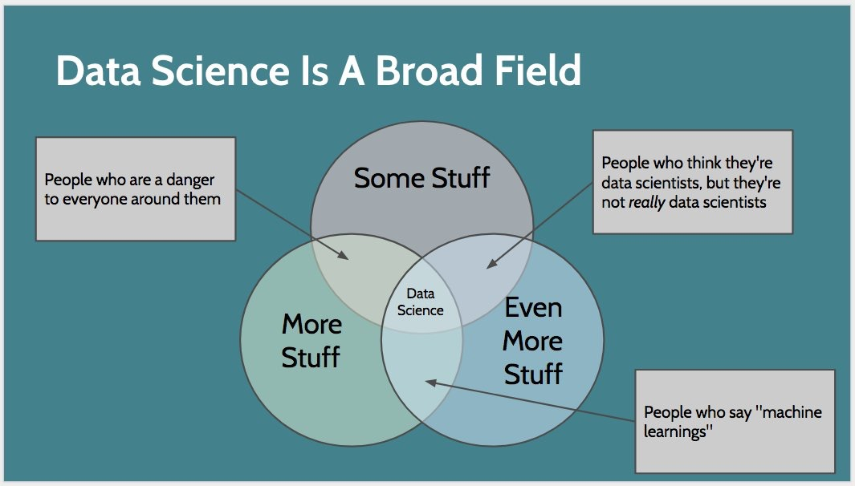
Notes:
https://www.datasciencecentral.com/profiles/blogs/difference-between-machine-learning-data-science-ai-deep-learning
Normalize the bullets in some way

Slide 15
Is Machine Learning a new concept?
The term Machine Learning may be relatively new
The algorithms behind them are anything but new

Slide 16
Techniques

Slide 17

Classification
Identifying to which of a set of categories (sub-populations) a new observation belongs, on the basis of a training set of data containing observations (or instances) whose category membership is known.
Is the movie coming out Fresh or Rotten?

Slide 18
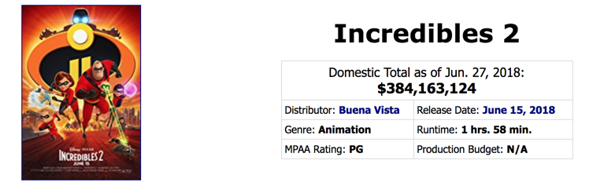
Regression
A set of statistical processes for estimating the relationships among variables. It includes many techniques for modeling and analyzing several variables, when the focus is on the relationship between a dependent variable and one or more independent variables (or 'predictors’).
How much money did the movie make?

Slide 19

Clustering
The task of grouping a set of objects in such a way that objects in the same group (called a cluster) are more similar (in some sense) to each other than to those in other groups (clusters).
Which customers are the most similar?
Can we create groups from this data?
I don’t know anything about these entities where do I start?

Slide 20
Anomaly Detection
The identification of items, events or observations which do not conform to an expected pattern or other items in a dataset. Typically the anomalous items will translate to some kind of problem such as bank fraud, a structural defect, medical problems or errors in a text.
How can we spot possible fraud?
Can I automate identifying outliers?

Slide 21
Process

Slide 22
Supervised vs Unsupervised Learning
Unsupervised Learning
Supervised learning
Unlabeled Data
Clustering (K-means)
Market Basket Analysis (Apriori Algorithm)
Anomaly Detection (Extreme Studentized Deviate Test)
Text mining (Latent Dirichlet Allocation)
Labeled Data
Anomaly Detection (Support Vector Machine)
Text mining (Support Vector Machine)
Regression (Linear Regression)
Classification (Random Forest)
Sentiment analysis (Neural Network)
Not mutually exclusive
Notes:
Ryan to workshop think in a diagram

Slide 23
Algorithm selection (Supervised Learning)
Supervised
Regression
Multi-Class Classification
2-Class Classification
Ordinal
Poisson
Logistic Regression
Neural Network
Support Vector Machine
Averaged Perceptron
Fast Forest Quantile
Linear
Decision Forest
Decision Jungle
Logistic Regression
Bayes Point Machine
Bayesian Linear
Neural Network
XGBoost
Decision Forest
Boosted Decision Tree
Decision Forest
Boosted Decision Tree
Decision Jungle
Locally Deep Support Vector Machine
ARIMAX
XGBoost
Neural Network
XGBoost
Notes:
Steal from cheat sheet. Color each path distinct

Slide 24
Algorithm selection (Unsupervised Learning)
Unsupervised
Anomaly Detection
Clustering
PCA-Based Anomaly Detection
One-Class Support Vector Machine
K-Means
Hierarchical
Extreme Studentized Deviate Test
Notes:
Steal from cheat sheet. Color each path distinct

Slide 25
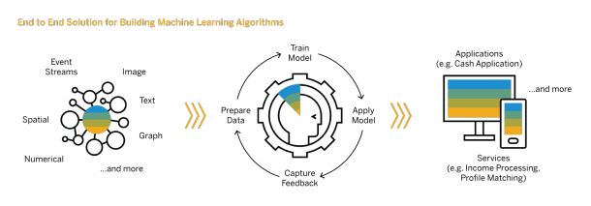
All models are wrong…but some are useful!
Notes:
Steal from cheat sheet. Color each path distinct

Slide 26
Tools

Slide 27






Machine Learning Options on Azure
Pre-Built
Custom
COGNITIVE SERVICES
SQL Server
AZURE
DATABRICKS
BOT SERVICE
AZURE ML Studio

Slide 28
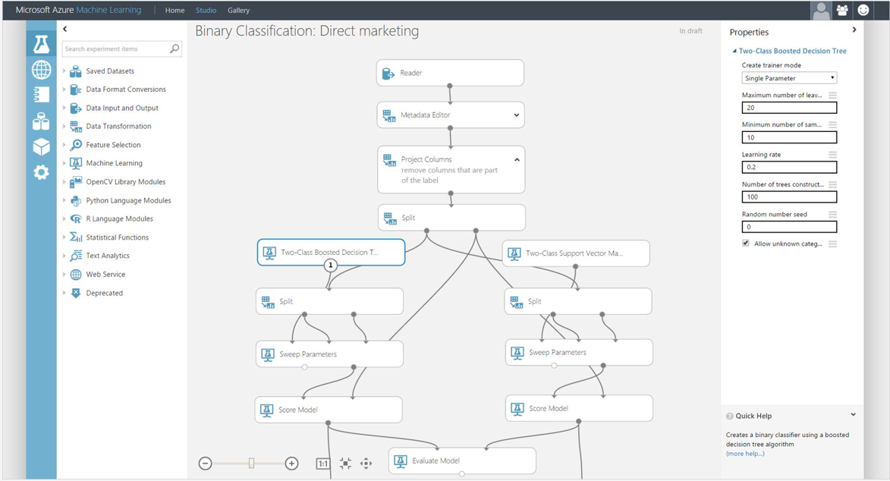
Azure Machine Learning Studio
Visual drag-and-drop

Slide 29



What is Azure Databricks?
A fast, easy and collaborative Apache® Spark™ based analytics platform optimized for Azure
Best of Databricks
Best of Microsoft
Designed in collaboration with the founders of Apache Spark
One-click set up; streamlined workflows
Interactive workspace that enables collaboration between data scientists, data engineers, and business analysts.
Native integration with Azure services (Power BI, SQL DW, Cosmos DB, Blob Storage)
Enterprise-grade Azure security (Active Directory integration, compliance, enterprise-grade SLAs)
Notes:
Azure Databricks features –
Enhance your teams’ productivity
Get started quickly by launching your new Spark environment with one click.
Share your insights in powerful ways through rich integration with PowerBI.
Improve collaboration amongst your analytics team through a unified workspace.
Innovate faster with native integration with rest of Azure platform.
Build on the most compliant and trusted cloud
Simplify security and identity control with built-in integration with Active Directory.
Regulate access with fine-grained user permissions to Azure Databricks’ notebooks, clusters, jobs and data.
Build with confidence on the trusted cloud backed by unmatched support, compliance and SLAs.
Scale without limits
Operate at massive scale without limits globally.
Accelerate data processing with the fastest Spark engine.

Slide 30
Spark in one sentence
A group of engineers started the Spark project with the singular goal to “democratize” the “superpower” of big data, by offering high-level APIs and a unified engine to do machine learning, ETL, streaming and interactive SQL.

Slide 31
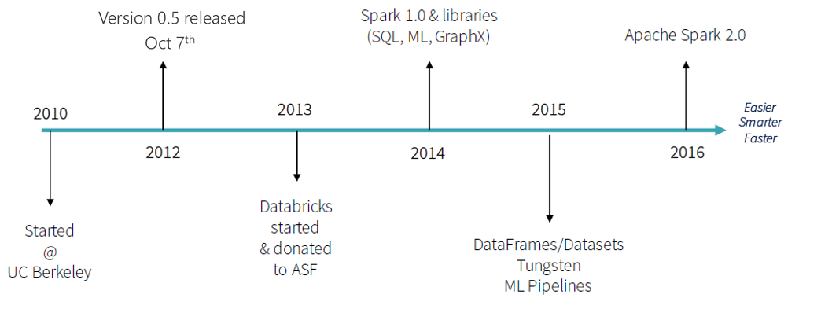
Spark: A brief history

Slide 32
Apache Spark
An unified, open source, parallel, data processing framework for Big Data Analytics
Spark Unifies:
Batch Processing
Interactive SQL
Real-time processing
Machine Learning
Deep Learning
Graph Processing
Spark SQL
Interactive Queries
Spark MLlib
Machine Learning
Spark Streaming
Stream processing
GraphX
Graph Computation
Spark Core Engine
Spark MLlib
Machine Learning
Spark Structured Streaming
Stream processing

Slide 33



Azure Databricks key audiences & benefits
Data scientist
Data engineer
CDO, VP of analytics
Integrated workspace
Easy data exploration
Collaborative experience
Interactive dashboards
Faster insights
Best Spark & serverless
Databricks managed Spark
Improved ETL performance
Zero management clusters, serverless
Easy to schedule jobs
Automated workflows
Enhanced monitoring & troubleshooting
Automated alerts & easy access to logs
Zero Management Spark
Cluster democratization (serverless)
Fast, collaborative analytics platform accelerating time to market
No dev-ops required
Enterprise grade security
Encryption
End-to-end auditing
Role-based control
Compliance
Unified analytics platform
Provided by Microsoft and Databricks under NDA

Slide 34
Workshop

